Slide 1
Lecture 4
Unsteady State Heat Transfer
Transient conditions occur for 2 reasons
The system energy inflow is different from the outflow
A change in the boundary conditions occurs
Two cases to be considered
Temperature changes with time but not position (Lumped Parameter Analysis)
Temperature changes with time and location

Slide 2
Lecture 4
Objectives
Describe heat transfer processes in which the temperature changes with time (unsteady
state) but not with the location (lumped parameter analysis)
Describe heat transfer processes under unsteady state, i.e. temperature changes with time, and also with the position (use of charts)
Describe the heat transfer process near the
surface of a large body (semi-infinite regions)

Slide 3
Transient heat transfer when internal resistance is negligible (i.e. temperature independent of position)
Lumped Parameter Analysis
Convection
T
Solid
Balance of Energy
Energy Balance Microscopic in Time

Slide 4
Lumped Parameter Analysis
T

Slide 5
Lumped Parameter Analysis
T(t)
t
If

Slide 6
Lumped Parameter Analysis
Solution relatively simple
How do we know that we can apply this analysis in a
particular heat transfer process?
Definition of Biot Number (B_{i})
Small Biot – Solid heat resistance is small – Lumped Parameter Analysis is appropriate
Large Biot – Solid heat resistance is large – Lumped Parameter Analysis is not appropriate

Slide 7
Biot Number (B_{i})
Characteristic Length (L_{c}) = Path of least thermal resistance
Heat Transfer
direction
Heat Transfer
direction
L_{c}
L_{c}
L_{c} ?
Heat Transfer
Direction ???

Slide 8
Biot Number (B_{i})
The error in the temperature calculations is less than 5%
Lumped Parameter Analysis Appropriate for:
Large surface areas
Small volumes
Small convective heat transfer coefficients
Large thermal conductivities

Slide 9
Example – Keeping eggs warms in an incubator
Incubator
h = 5.2 W/m².K
Egg
T_{i} =20ºC
Estimate the temperature of the egg after 1 hour in the incubator
Assume that the egg is spherical
Redo the analysis for a boiling egg, h = 10,000 W/m².K.
Could we use the Lumped Parameter Analysis?

Slide 10
ENERGY EQUATION – the Unsteady State Condition
Transient
Convection
fluid velocity
independent
of position
Conduction
Generation
term
Let’s assume no heat generation and no convection

Slide 11
Energy Equation in Cartesian Coordinates
No convection
No heat Generation
Solution
time
location
Let’s consider now 1D heat flow (e.g. only direction x)
Solution

Slide 12
Transient Analysis – Internal heat resistance in the solid is not negligible
T=T_{S}
T=T_{S}
Symmetry
x=-L
x=0
x=L

Slide 13
Transient Analysis – Internal resistance in the solid is not negligible
The solution of this partial differential equation can be obtained by using
the separation of variables method
Position dependence
Time dependence

Slide 14
Transient Analysis – Changes with time
Linear Relationship between and t

Slide 15
Transient Analysis – Changes with position
Spatial Average
For long times
For a given time t (but long time), temperature varies with the cosine of the position x
For practical situations we need to know
the average temperature T_{av}

Slide 16
Transient Analysis – Change with size
The time necessary to achieve a given average temperature increases with the
square of the thickness (characteristic dimension for a slab)

Slide 17
Fourier Number F_{o}
Two dimensionless parameters can be used to define position and time

Slide 18
Slab Solutions
Parameters in the Equation
L
x

Slide 19
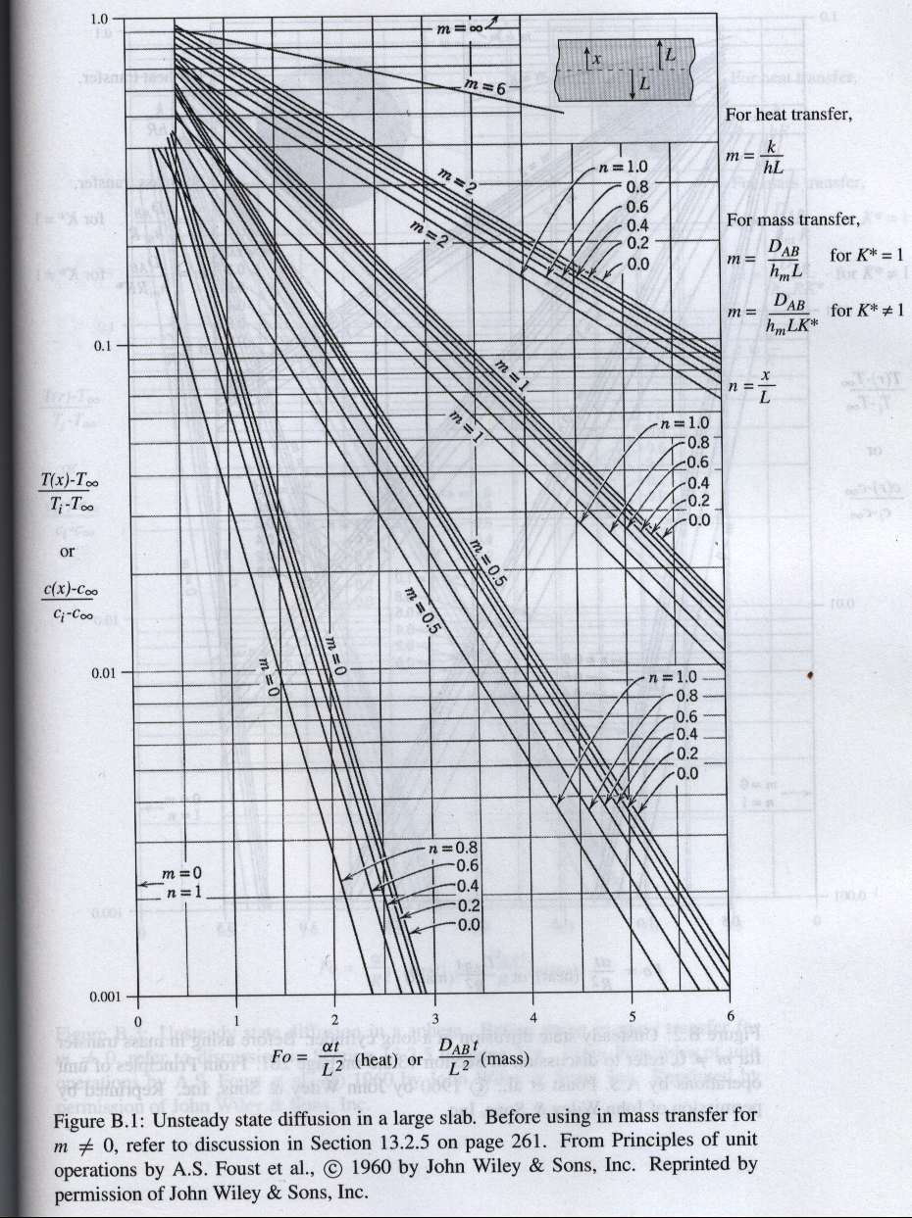
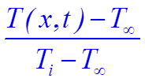
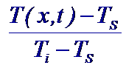
Slab Geometry
or

Slide 20
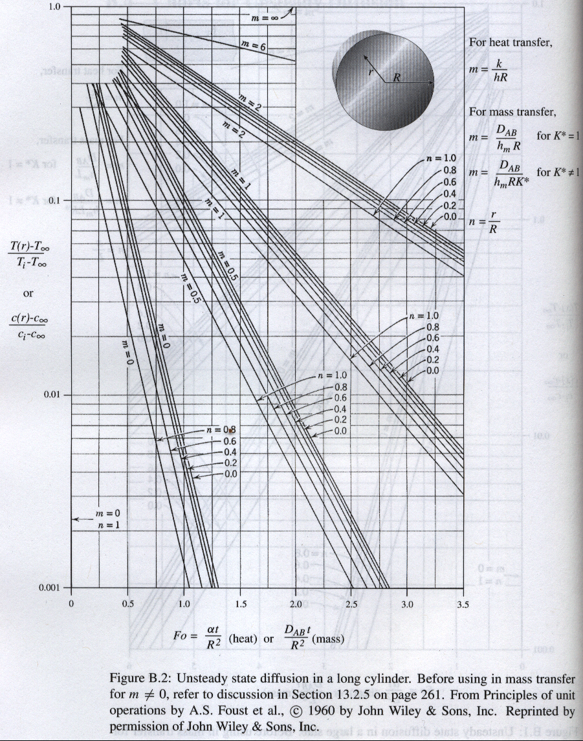
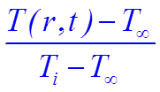

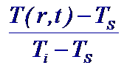
Cylinder Geometry

Slide 21
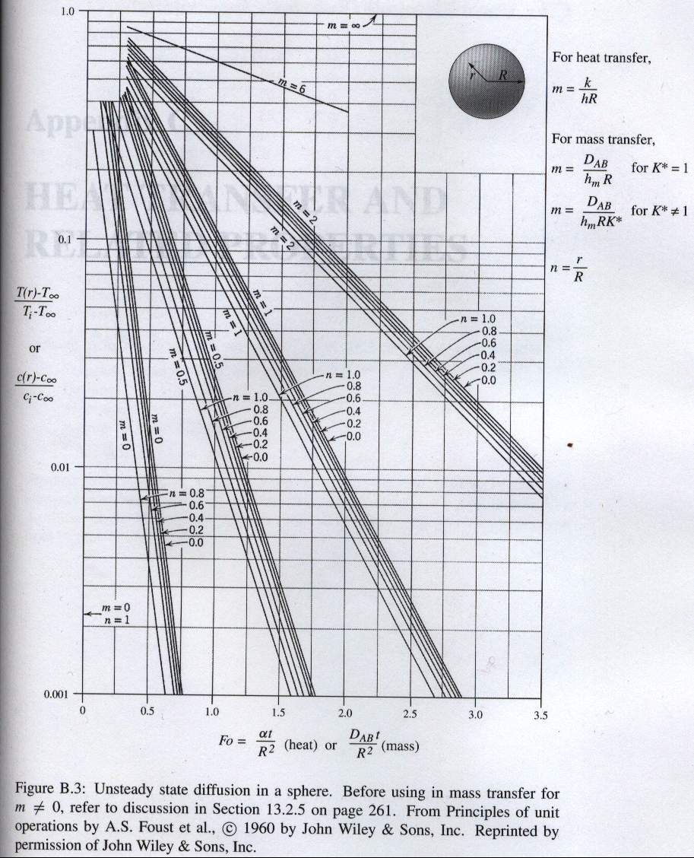
or

Slide 22
Conditions to be satisfied for use of charts
Uniform initial temperature
Perfect slab, cylinder or sphere
Far from edges
No heat generation ( )
Constant thermal properties (k, , c)
Typically for times long after initial times, given by
For cases in that convection resistance is appreciable, the equation should
be changed, the parameter m = k/hL = 1/Bi is introduced . Temperature should
be changed to:
T
Fluid
Fluid
r

Slide 23
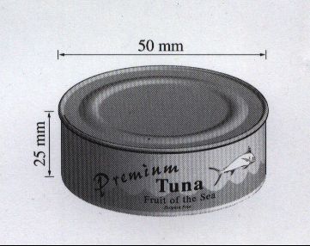
Example - Temperatures reached during food sterilization
Because we are using a “slab” model – we will have to use
corresponding chart
Time
Position
External conditions

Slide 24
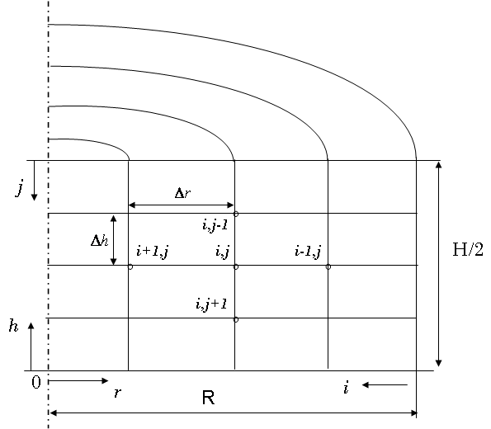
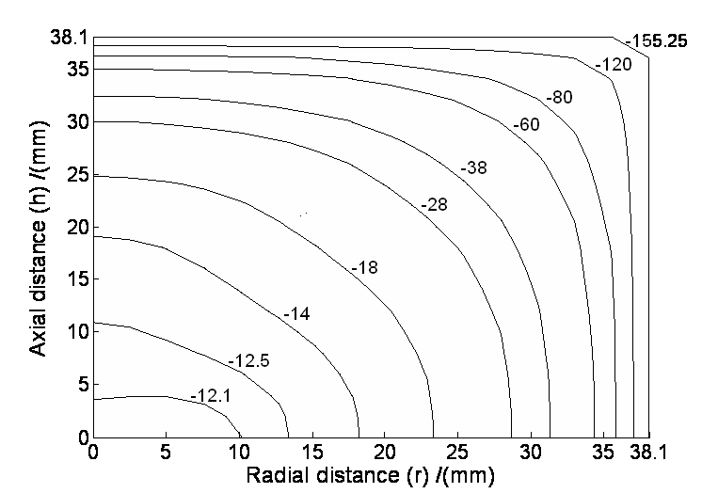
Numerical Methods – Finite Element or Finite Differences
Geometry
Results
Calculations
Extent of Sterility S(t)
For complete Sterilization of the food
is required a time of S(t) =12 at the
slowest heating point (center of the can
in conduction heating products)
Heating History (center)
Microbiological
Parameter (death kinetics)
Reference Temperature (121ºC)

Slide 25
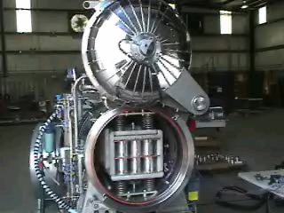
Numerical Methods
Sakra Process
Main Concerns: Non-uniform temperature distributions (and S ) in the food
Proteins
Sugar
Starch
…..
Extremely High Temperatures
in part of the can
Poor Texture
Off flavours
Maillard Products (carcinogenic?)

Slide 26
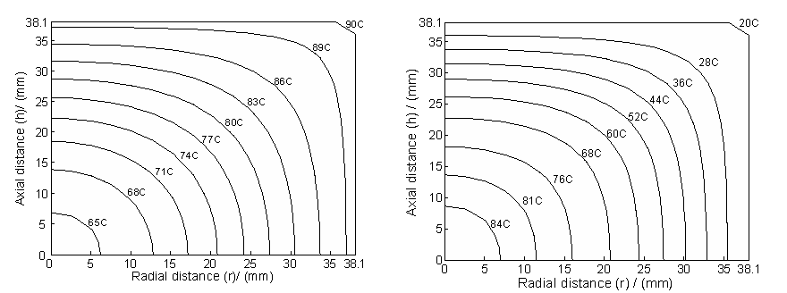
Numerical Methods
They can handle odd geometries
Varying thermal properties
Varying external heating (e.g. changing outside heating temperatures)
Non-uniform initial conditions
Temperature Profile after a preheating treatment
Temperature Profile after a precooling treatment

Slide 27
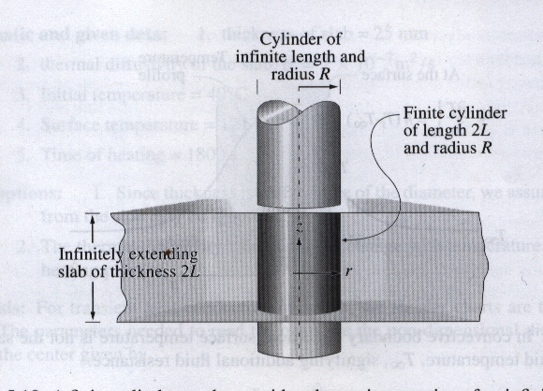
Transient Heat Transfer in a Finite Geometry – using charts
Multi-Dimensional Problems
Finite Cylinder (Can)
Infinite cylinder
Infinite slab
Finite Rectangular geometry (Heat transfer in x, y and z directions

Slide 28
Transient Heat Transfer in a Semi-Infinite Region

Slide 29
Transient Heat Transfer in a Semi-Infinite Region
Solution
Error Function

Slide 30
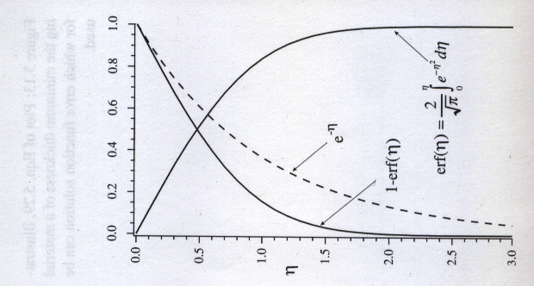
Error Function - erf (x)

Slide 31
Other boundary conditions for the semi-infinite
body problem

Slide 32
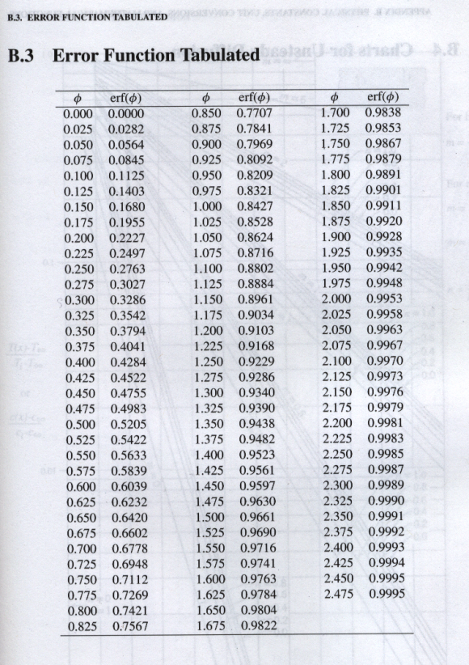
Convective Heat Transfer Boundary Condition
= 0

Slide 33
Specified surface heat flow at the surface

Slide 34
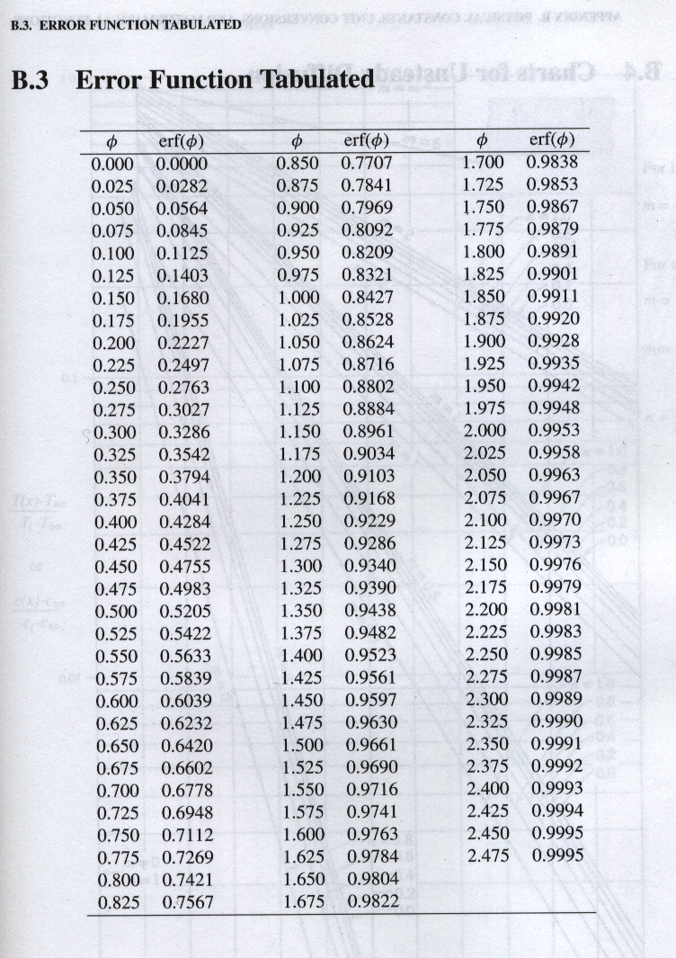
Error Function - erf (x)

Slide 35
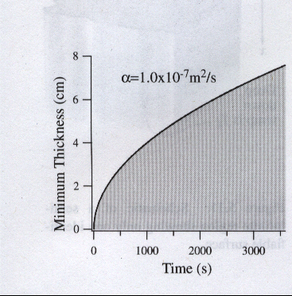
Useful/Practical Calculations
Where could we use these solutions?
q
For relatively long systems (not infinite), and slow conduction the
right edge does not “realize” for a while that the left edge has now a
temperature T_{S} so during that time we can use these solutions
The temperature change
is less that 0.5%
We can consider this solution

